Slide 1
Topic 5 Nonparametric filters (Reference 2, Ch. 4)

Slide 2
Autonomous mobile robots
autonomy
Vehicle
Actuators
Vehicle model
Sensors
Control
Vehicle autonomy
Path & motion planning
Localization
Perception
Independent from user
Localization & mapping
Independent from environment

Slide 3
Introduction
A popular alternative to Gaussian techniques are nonparametric filters.
Nonparametric filters do not rely on a fixed functional form of the posterior.
Instead they approximate posteriors by a finite number of values, each roughly corresponding to a region in state space.

Slide 4
Introduction
Some rely on a decomposition of the state space, in which each such value corresponds to the cumulative probability of the posterior density in a compact sub-region of the state space.
Others approximate the state space by random samples drawn from the posterior distribution.
The quality of the approximation depends on the number of samples used to represent the posterior.
As the number goes to infinity, nonparametric techniques tend to converge to the correct posterior.

Slide 5
Two nonparametric approaches
The first decomposes the state space to finitely many regions, and represents the posterior by a histogram, which assigns to each region a cumulative probability.
The second technique represents posteriors by finitely many samples. This filters is known as a particle filter. It is immensely popular in robotics.
Both techniques do NOT make strong parametric assumptions on the posterior density. This makes them well-suited to represent complex multimodal beliefs.

Slide 6
Introduction
Nonparametric techniques are the method of choice when a robot has to cope with phases of global uncertainty.
Unfortunately the representational power of these techniques comes at the price of added computational complexity.
Techniques that can adapt the number of parameters to represent the posterior online are called adaptive.

Slide 7
Topological vs. metric representations
Topological: coarse graph-like representation, where nodes in the graph correspond to significant places in the environment (e.g., intersections, T-junctions, dead ends)
Grid representation: using regularly-spaced grids. It is considered as a metric technique.
The spatial resolution of grid representation is often higher than that of topological representation.
The increased accuracy comes at the price of computational cost.

Slide 8
The particle filter
The particle filter is an alternative nonparametric implementation of Bayes filter.
Particle filters approximate the posterior by a finite number of parameters.
A particle filter has a unique way in which parameters are generated, and in which they populate the space.
The key idea is to represent the posterior bel(x_{t}) by a set of random samples drawn from this posterior.

Slide 9
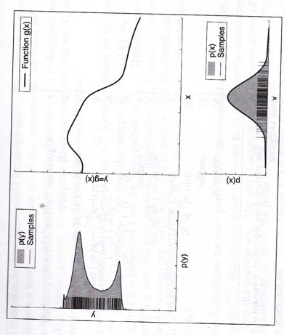
The particle representation

Slide 10
Particle filter (PF)
Instead of representing the Gaussian by parameters, in a particle filter it is represented by a set of samples drawn from this distribution.
While this representation is approximate, it is nonparametric.
Therefore it can represent a much broader space of distributions than Gaussians.
Furthermore, PF can represent non-linear transformations of random variables.

Slide 11
PF, cont…
In PFs the samples of a posterior distribution are called particles and denoted by:
[m]
Each particle x_{t} (with 1≤ m ≤ M) is an instantiation of the state at time t. M is the # of particles in the particle set X_{t}. M is large ≈1000
A particle is a hypothesis as to what the true world state may be at time t.

Slide 12
PF cont…
The likelihood for a state hypothesis x_{t} to be included in the particle set X_{t} is proportional to its Bayes filter posterior bel(x_{t}).
The denser a sub-region of state space is populated by samples the more likely it is that the true state falls into this region.

Slide 13
PF cont…
Just like all other Bayes filter algorithms, the particle filter constructs the belief bel(x_{t}) recursively from the bel(x_{t-1})
Since beliefs are represented by a set of particles this means that particle filters construct the particle set X_{t} recursively from the set X_{t-1}.
Sampling is done for each particle using the state transition model.
Importance factors are used to incorporate the measurement z_{t} under the particle x_{t}

Slide 14
The particle filter
sampling from the state transition model
importance factor
resampling or importance sampling

Slide 15
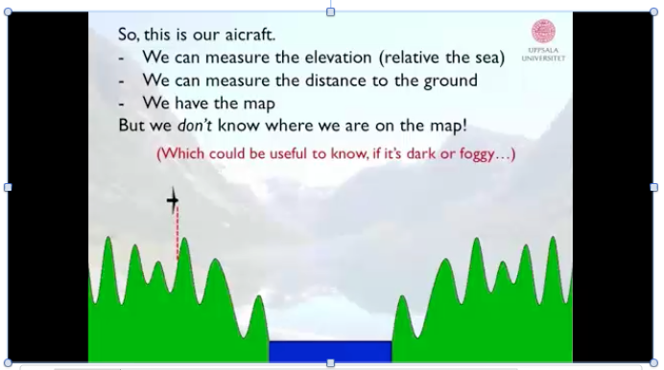
Problem definition

Slide 16
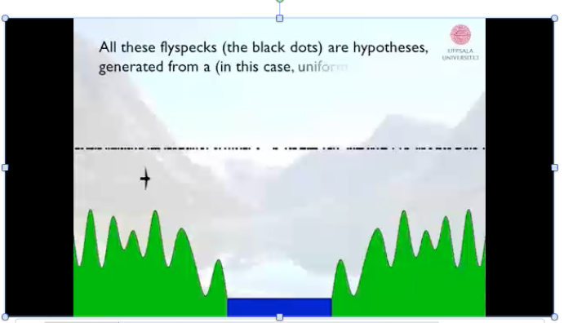
Initiate with a uniform distribution

Slide 17
The particle filter
sampling from the state transition model
importance factor
resampling or importance sampling

Slide 18
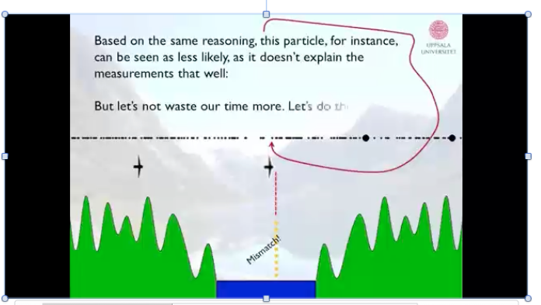
Find weights

Slide 19
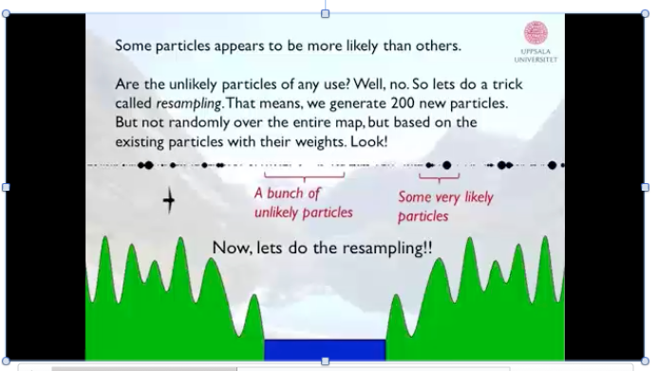
Final weights

Slide 20
The particle filter
sampling from the state transition model
importance factor
resampling or importance sampling

Slide 21
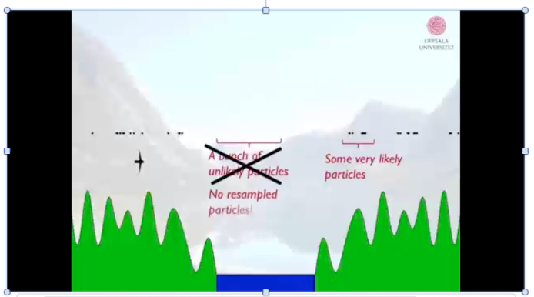
Resample based on weights

Slide 22
The particle filter
sampling from the state transition model
importance factor
resampling or importance sampling

Slide 23
PF…
Resampling transforms a particle set of M particles into another particle set of the same size.
By incorporating the importance weights into the resampling process, the distribution of the particles changes:
Before the resampling distributed according to:
After the resampling distributed according to the posterior:

Slide 24
PF cont..
The resulting sample set usually possesses many duplicates, since particles are drawn with replacement.
The resampling step has the important function to force particles back to the posterior bel(x_{t}).

Slide 25
Importance Sampling
The problem at hand is to compute an expectation over a probability density function f, but we are only given samples generated from a different PDF, g.
For example we might be interested in an expectation that:
indicator function
weighting factor
f(x) > 0, g(x)>0

Slide 26
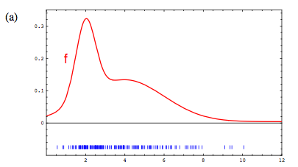
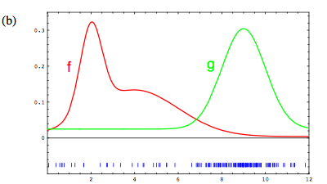
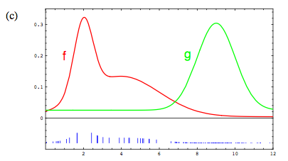
Proposal distribution
Target distribution

Slide 27
PF cont…
The empirical count of particles that fall into A converges to the integral of g under A.
To offset this difference between f and g, particles x[m] are weighted by the quotient

Slide 28
PF cont..
Importance weights are the non-normalized probability mass of each particle:
normalizer
Even though we generated particles for the density g, the appropriately weighted particles converge to the density f.

Slide 29
PF cont…
The density g corresponds to the product distribution, called the proposal distribution:

Slide 30
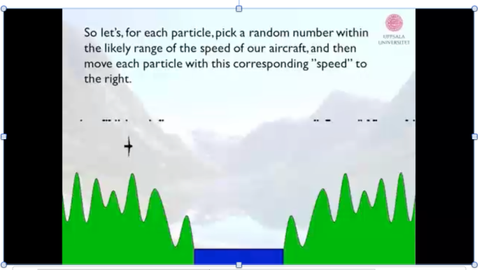
Propagate particles forward using motion constraints

Slide 31
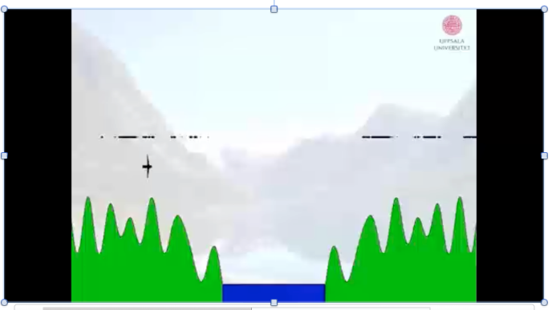
The new hypothesized locations

Slide 32
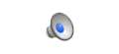
And then repeat…
Andreas Svensson http://www.youtube.com/watch?v=aUkBa1zMKv4

Slide 33
Practical Considerations
Density estimation: the problem of extracting a continuous density from PF samples is called density estimation.
A simple and efficient approach to do so is to compute a Gaussian approximation.
A Gaussian approximation captures only basic properties of a density and is only appropriate if the density is unimodal.
Multimodal distributions require k-means to approximated the density with a mixture of Gaussians.

Slide 34
Density estimation
Another method is to superimpose a discrete histogram over the state space.
The probability of each bin is computed by summing the weights of the particles that fall into its range.
A problem with this method is that the space complexity is exponential in the number of dimensions.
On the other hand, histograms can represent multi-modal distributions, and can be computed efficiently.

Slide 35
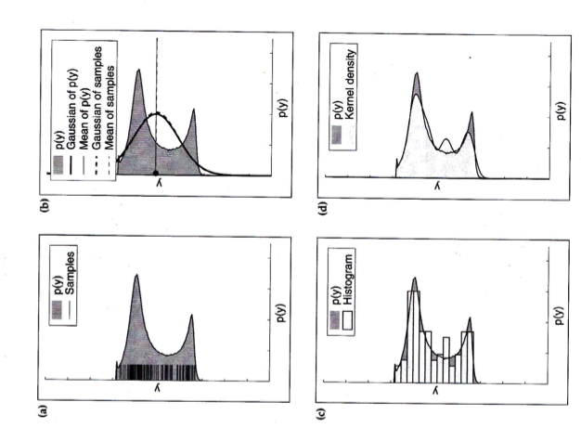
Extracting densities

Slide 36
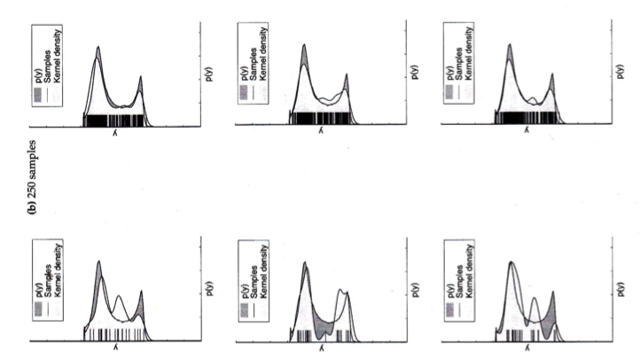
Extracting densities (# of particles)

Slide 37
Sampling Variance
An important error in PF relates to the variation inherent in random sampling.
Whenever a finite # of samples is drawn from a PDF, statistics extracted from these samples differ slightly from the statistics of the original density.
Variability due to random sampling is called variance of the sampler.
The sampling variance decreases with the number of samples (see previous slide). If enough samples are chosen, the sample-based belief is close enough to the true belief.

Slide 38
Resampling
The sampling variance is amplified through repetitive resampling.
Take an example of a robot parked in one spot.
Initially the particle set is generated from the prior.
The resampling step occasionally fails to produce a state sample x^{[m]}.
As time goes on more and more particles are erased due to the random nature of the resampling step, without the creation of new particles.
With probability 1, M identical particles of a single particle will survive.

Slide 39
Resampling cont…
The resampling process induces a loss of diversity in the particle population, which is manifested as approximation error.
Even thought the variance of the particle set itself decreases, the variance of the particle set as an estimator of the true belief increases.

Slide 40
Variance reduction
2 methods for variance reduction
reduce frequency at which resampling takes place (never resample when the state is static). the choice of when to sample is an artwork.
low variance sampling: here instead of selecting samples independently of each other in the resampling process, the selection involves a sequential stochastic process.

Slide 41
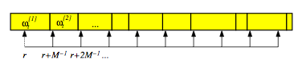
Low variance sampling

Slide 42
Low-variance sampling
The importance of low-variance sampling is threefold
It covers the space of samples in a more systematic fashion than the independent random sample
If all the samples have the same importance factors, the resulting sample set is equivalent to X_{t}. No samples are lost if we have no measurements.
The low-variance sampler has a complexity of O(M), Computation time is of essence when using a PF.

Slide 43
Particle deprivation
It may happen that there are no particles in the vicinity of the correct state. This is known as the particle deprivation problem.
It occurs when the number of particles is too small to cover all relevant regions with high likelihood.
Particle deprivation occurs as a result of variance in the random sampling. An unlucky series of random numbers can wipe out all particles near the true state.
A practical solution is to add a small number of randomly generated particles into the set after each resampling process.

